Slide 1
Database Documentation is easy with extended properties
Robert Minchin
BI Consultant - SSAS and Data Warehouse
https://github.com/Robertx0Sql/
robertx0sql@gmail.com
Notes:
Documentation is hard when we have to use Word etc.

Slide 2
Database Documentation with Extended properties
What are Extended properties?
Centralised Documentation Management System
The Documentation Management Database
Extracting Data from a Source Database
Reports
Notes:
I AM GOING TO TALK ABOUT ….

Slide 3
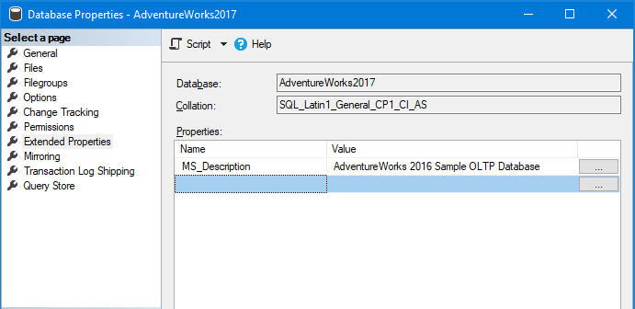
Extended Properties
Can add properties for Database , Objects , columns and Procedure/Trigger parameters and more.
Name is ‘MS_Description’
Notes:
Database Properties dialog from Management Studio – set the Name to MS_Description and the value to ….

Slide 4
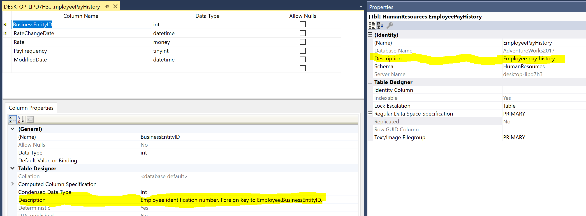
Table / Column Extended Properties
EXEC sys.sp_addextendedproperty @name=N'MS_Description’
, @value=N'Primary key for Employee records. Foreign key to BusinessEntity.BusinessEntityID.’
, @level0type=N'SCHEMA',@level0name=N'HumanResources'
, @level1type=N'TABLE',@level1name=N'Employee' , @level2type=N'COLUMN',@level2name=N'BusinessEntityID'
Notes:
IN Management Studio:
use AdventureWorks2017;
go
/* table data */
EXEC sys.sp_addextendedproperty @name=N'MS_Description'
, @value=N'Employee information such as salary, department, and title.'
, @level0type=N'SCHEMA',@level0name=N'HumanResources'
, @level1type=N'TABLE',@level1name=N'Employee'
/* Column Level Properties*/
GO
EXEC sys.sp_addextendedproperty @name=N'MS_Description'
, @value=N'Primary key for Employee records. Foreign key to BusinessEntity.BusinessEntityID.'
, @level0type=N'SCHEMA',@level0name=N'HumanResources'
, @level1type=N'TABLE',@level1name=N'Employee'
, @level2type=N'COLUMN',@level2name=N'BusinessEntityID'
GO

Slide 5
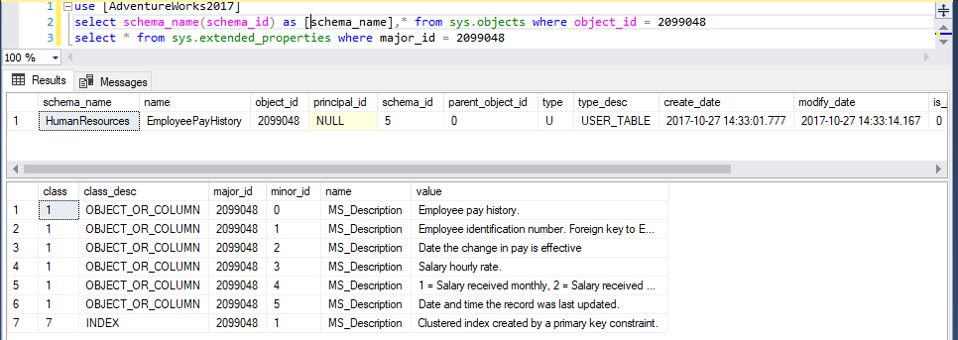
Get the data from Extended Properties
sys.extended_properties Catalog View
Class defines the type of object to query – defined in MS Docs (referenced at end of slides)
Notes:
Here are all the related poperty values for an object (objects, attributes and index/triggers) – note PK and Fks are child objects.
select * from sys.extended_properties
use [AdventureWorks2017]
select schema_name(schema_id) as [schema_name],* from sys.objects where object_id = 2099048
select * from sys.extended_properties where major_id = 2099048

Slide 6
Demo
Add Extended properties to a table
Get the Extended properties for objects and attributes
Notes:
Create test database
Create a table with 1 field.

Slide 7
Centralised Documentation Management Requirements
Single point for customers (users) to see documentation of the Databases and Cubes.
Drilldown between linked objects (such as views and tables)
But no FK in the Data Warehouse - infer FK by convention
Data provenance Reporting – how is a metric calculated

Slide 8
Implementation
Single Documentation DB
Database Documentation
Cube Documentation – Tabular or MD
Load using PowerShell
Reports – SSRS

Slide 9
PowerShell
2 Scripts
Cube
CubeDocfromDMV.ps1
needs AD access to SSAS server
Database
SQLDocPass.ps1
Either AD or SQL account access (db_datareader role)

Slide 10
Cube load
DMV information from SSAS Server
MDSCHEMA_CUBES
MDSCHEMA_DIMENSIONS
MDSCHEMA_MEASUREGROUP_DIMENSIONS
MDSCHEMA_MEASUREGROUPS
MDSCHEMA_MEASURES
MDSCHEMA_LEVELS
Simple lift and copy to tables in the Document Database

Slide 11
Database load
Simple copy from sys.extended_properties ? Not so much.
7 import queries
Documentation (using sys.extended_properties )
Object and attributes (name ,datatype & description )
Objects (tables / views / procedures / triggers / indexes / PK / FK)
Database and properties
Other
Object References
sys.sql_expression_dependencies and sys.dm_sql_referencing_entities
FK referenced tables and columns
View column source - INFORMATION_SCHEMA.VIEW_COLUMN_USAGE
Code - create statement for object using SMO (can be slow)
Infer FK for DW by convention where none exists. (“AutoFK”)

Slide 12
Powershell load examples
Cube
.\CubeDocfromDMV.ps1 -SSASServer . -SSASDatabase "Adventure Works Internet Sales Database" -DocServer .
Database
.\SQLDocPass.ps1 -SourceServer . -SourceDatabase AdventureWorks2017 -DocServer . –Verbose
SQL user access => Get-Credential :
.\SQLDocPass.ps1 -SourceServer . -SourceDatabase AdventureWorks2017 -DocServer . -DocCredential Get-Credential –Verbose

Slide 13
Reporting
SSRS
Based on Cube Documentation Reports from Purple Frog Systems
Supports Geometry Spatial Maps
Tabular reporting
Driven by Stored Procedures
User mode – shows only Tables and views (not procedures etc)
Reports
SQLDb Documentation
SQLDoc_Search
CubeDoc_Cubes
CubeDoc_Search

Slide 14
Demo

Slide 15
References
sys.extended_properties details
https://docs.microsoft.com/en-us/sql/relational-databases/system-catalog-views/extended-properties-catalog-views-sys-extended-properties?view=sql-server-2017
https://www.mssqltips.com/sqlservertip/5384/working-with-sql-server-extended-properties/
https://www.red-gate.com/simple-talk/sql/database-delivery/reading-writing-creating-sql-server-extended-properties/
https://blogs.lessthandot.com/index.php/datamgmt/datadesign/document-your-sql-server-databases/
Purple Frog Cube Documentation
https://www.purplefrogsystems.com/blog/2010/09/olap-cube-documentation-in-ssrs-part-1/

Slide 16
Questions ?
Robert Minchin
BI Consultant - SSAS and Data Warehouse
https://github.com/Robertx0Sql/
robertx0sql@gmail.com
Notes:
Documentation is hard when we have to use Word etc.

